Slide 1



Slide 2
TECHNO INDIA NJR INSTITUTE OF TECHNOLOGY
Topic :
World Happiness Research Report
PALASH SIYAL
SRUSHTI CHOUDHRI
GUIDED BY :
Mr. Aaditya Maheshwari
18ETCCS069
18ETCCS083

Slide 3


ABOUT :
THE WORLD HAPPINESS RESEARCH REPORT IS A DATA SCIENCE PROJECT PORTRAYING A DETAILED REPORT FOR UNDERSTANDING HOW THE HAPPINESS OF CITIZENS IS AFFECTED BY SIMPLE FACTORS SUCH AS PHYSICAL/MENTAL HEALTH, WORK-LIFE, AND FAMILY SUPPORT.
THE PROJECT WILL BE BASED ON THE AVAILABLE GLOBAL DATA ON NATIONAL HAPPINESS
AND REVIEWED BASED ON THE EMERGING KNOWLEDGE & SCIENCE OF HAPPINESS, SHOWING THAT THE QUALITY OF PEOPLE’S LIVES CAN BE REASONABLY AND AUTHENTICALLY ASSESSED BY A VARIETY OF PERSONALIZED WELL-BEING MEASURES, COLLECTIVELY RESULTING IN THE HAPPINESS REPORT.

Slide 4

SCOPE
The Happiness Index is a tool
for the use of researchers,
community organizers and policy
makers seeking to understand
and enhance individual
happiness, community well-
being, social justice, economic
equality, and environmental sustainability.
The Index reflects a new
worldwide demand for more
attention to happiness as a criterion for government policy
The Index is also a tight slap
on the face of policy makers, who
think that pursuit of a healthy
GDP number alone is sufficient
to mark the happiness of a nation.

Slide 5


FACTORS :
Ladder Score
GDP
Social Support Healthy Life
Freedom to make life choices Generosity
Perceptions of Corruptions

Slide 6
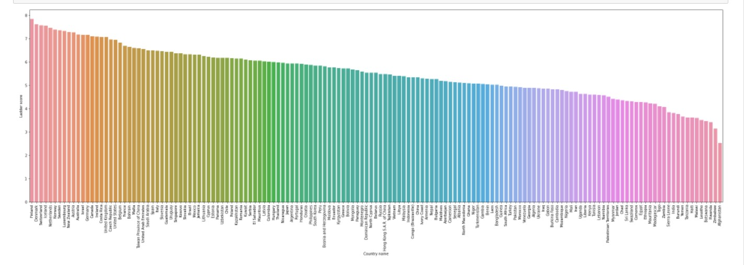
LADDER SCORE
Monday Tuesday Wednesday Thursday Friday

Slide 7
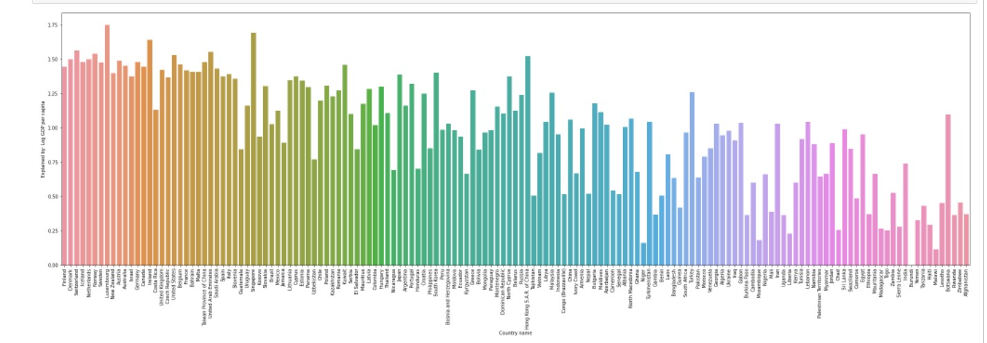
GDP
Monday Tuesday Wednesday Thursday Friday

Slide 8
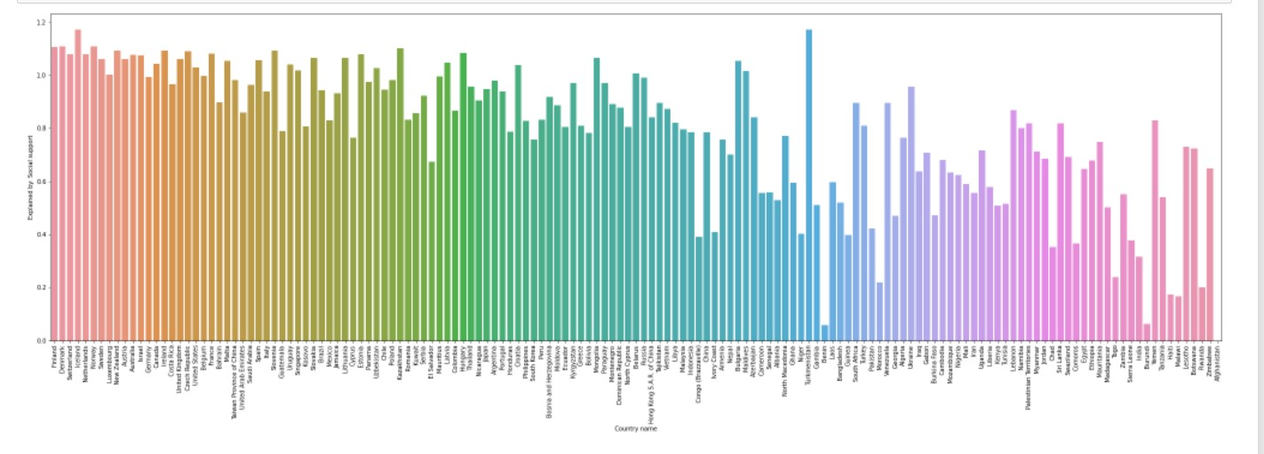
SOCIAL SUPPORT
Monday Tuesday Wednesday Thursday Friday

Slide 9
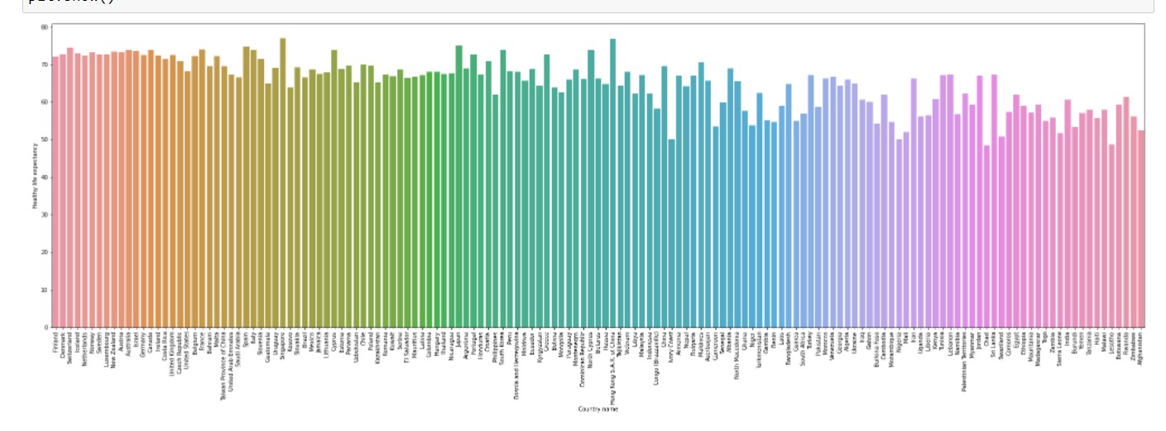
HEALTHY LIFE EXPECTANCY
Monday Tuesday Wednesday Thursday Friday

Slide 10
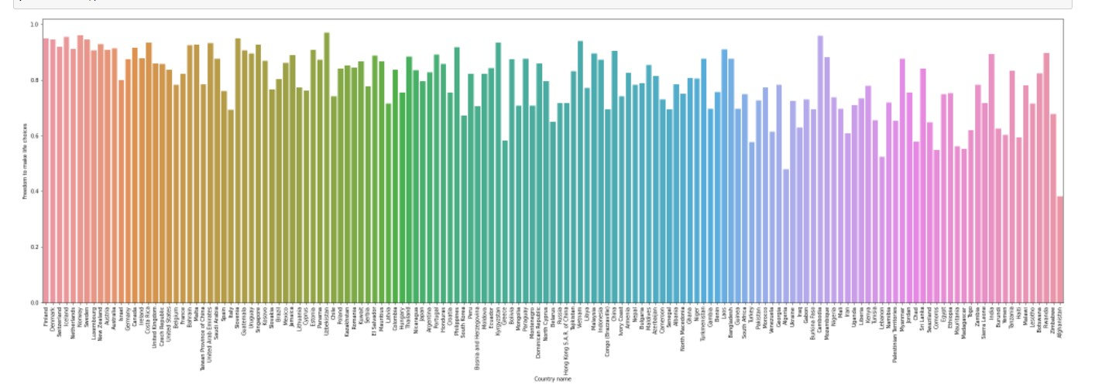
FREEDOM TO MAKE LIFE CHOICES
Monday Tuesday Wednesday Thursday Friday

Slide 11
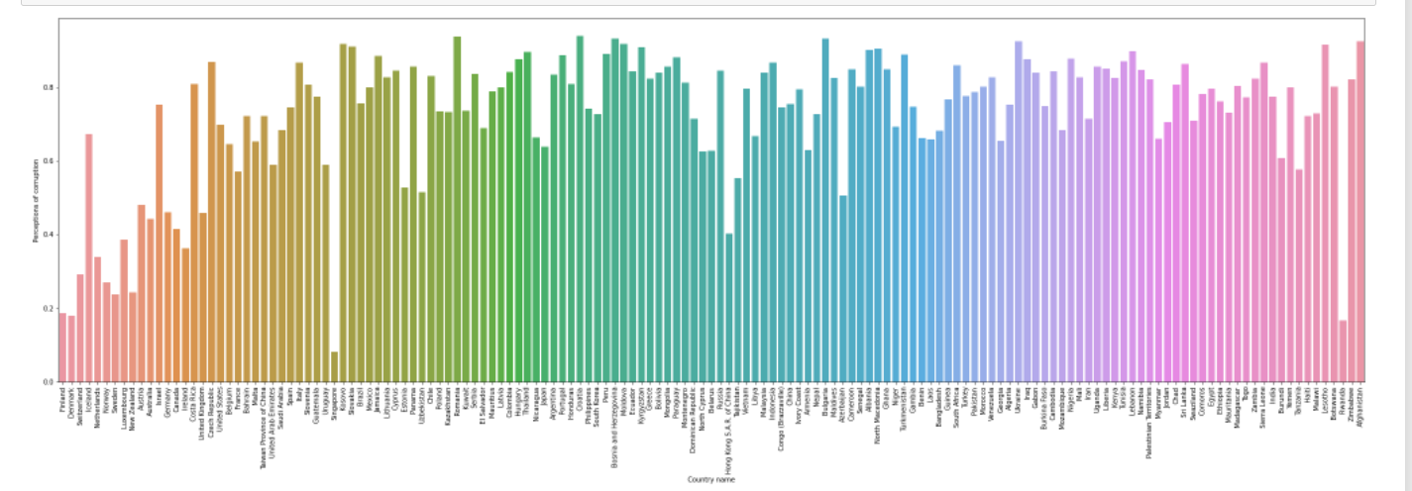
PERCEPTIONS OF CURROPTIONS
Monday Tuesday Wednesday Thursday Friday

Slide 12
LIMITATIONS
·There is huge difference between evaluations and experiences of well- being. For example, Columbia came 37th rank in 2018 world happiness report but 1st by daily emotional experience.
·World Happiness Report are more appropriate for measuring national- level rather than individual-level happiness.

Slide 13
CONCLUSIONS
Regular collection of happiness data on a large scale can inform policy-making and help us identify what "deliverables" should be created to foster well-being.
Absolute income is important in poor countries, but rich countries tend to place more importance on comparative income. Other factors with a strong impact on happiness include quality of work, social trust, freedom of choice, and political participation.

